Slide 1
Introduction to Information Systems
Information System Management
Course No: 0612-301
Md. Manirujjaman
Lecturer, CSE
DIU

Slide 2
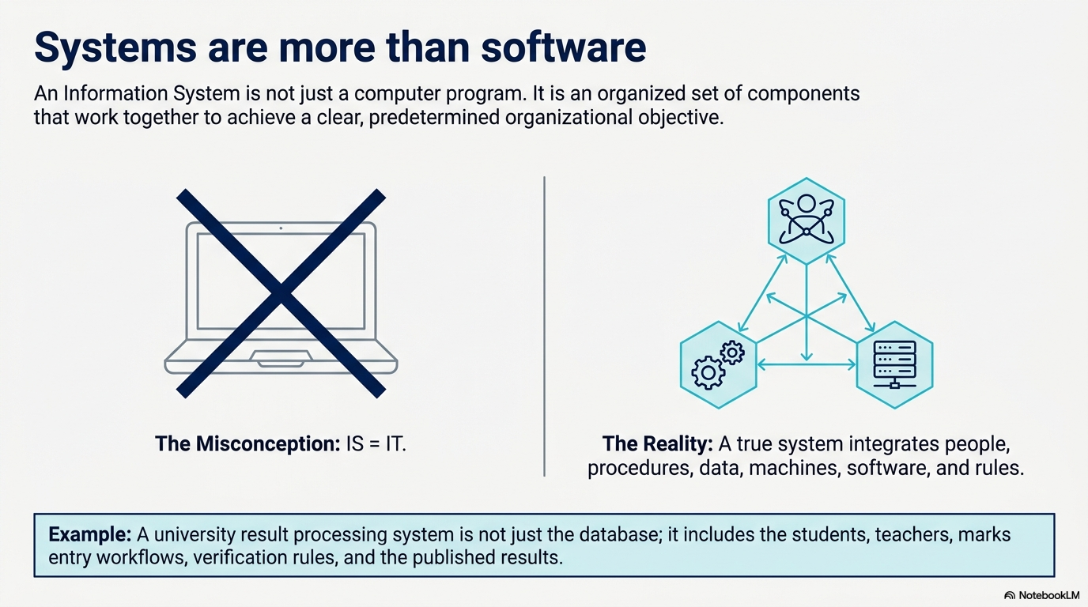

Slide 3
System Concept
A system –
A way of thinking about organizations and their problems.
Involves a set of techniques that helps in solving problems.
An organized relationship among functioning units.
An orderly grouping of individual components linked together to achieve specific objective/s.
Each component is part of the total system and has to do its share of work for the system to achieve the intended goal.
Components may refer to physical parts, managerial steps, etc.
Notes:
A university is a system because it has several interconnected parts—such as the administration, HR, accounts, IT, and academic departments. Each part performs its own function, but all work together to achieve a common goal: providing quality education to students.

Slide 4
System Concept
Therefore, The study of systems concepts has three basic implications –
A system must be designed to achieve a predetermined objective
Interrelationships and interdependence must exist among the components.
The objectives of the organization as a whole have a higher priority than the objectives of its subsystems.
Notes:
A system is goal-oriented: Every system is created to achieve a specific purpose. For example, a university’s system is designed to provide quality education.
All parts are connected and depend on each other: Each department or unit in a system must work together. For instance, in a hospital, the doctors, nurses, and billing department depend on each other to serve patients effectively.
The overall goal is more important than individual goals:
The main objective of the whole organization comes first. For example, in a university, if the HR department recruits fewer teachers than actually needed to reduce salary costs, it may lower the overall education quality. Therefore, the university’s main goal of providing quality education should come before departmental cost-saving goals.
ধরুন, একটি জুতো তৈরি করার কোম্পানির মূল উদ্দেশ্য (Main Objective) হলো ১০০০ টাকা বাজেটের মধ্যে কাস্টমারকে সেরা জুতো দেওয়া। এখন কোম্পানির "Purchasing Department" (সাব-সিস্টেম) ভাবলো, 'আমরা যদি সস্তা ও নিম্নমানের চামড়া কিনি, তাহলে আমাদের ডিপার্টমেন্টের অনেক টাকা বাঁচবে এবং আমাদের প্রশংসা হবে।' কিন্তু এতে জুতোর কোয়ালিটি খারাপ হয়ে গেল এবং কোম্পানির নাম ডুবে গেল। এখানে সাব-সিস্টেম নিজের স্বার্থকে বড় করে দেখায় সিস্টেমটি ফেইল করলো। তাই নিয়ম হলো, কোম্পানির মূল উদ্দেশ্যকে আগে প্রায়োরিটি দিতে হবে।

Slide 5
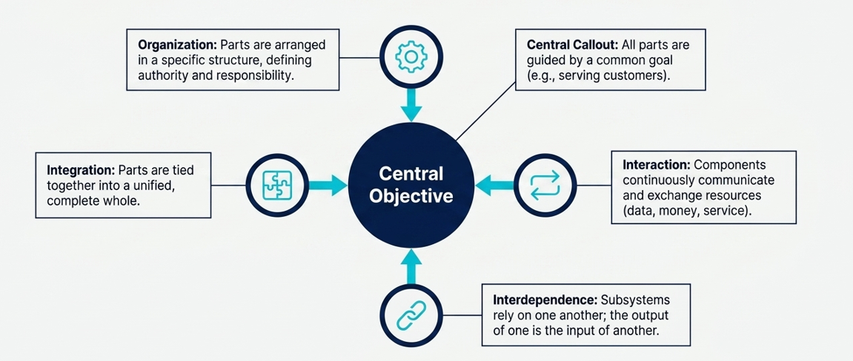
Characteristics of a System
For a system to function, its components cannot exist in isolation. They must be aligned.
Organization
Interaction
Interdependence
Integrations
Central objective
Notes:
1. Organization
A system has organized parts or components arranged in a specific order to achieve a goal. Each part has a role and works according to a plan.
Example: In a university, departments like CSE, EEE, and BBA are organized under different faculties, but all follow the university’s structure to maintain smooth operations.
2. Interaction
All components of a system interact with each other to exchange information or resources. These interactions help the system work as a whole.
Example: When a student pays tuition fees, the finance system updates the record, and the academic system allows the student to register for courses.
Interdependence
Each part of a system depends on other parts. If one part fails, it can affect the entire system.
Example: In a software company, the testing team depends on the development team to deliver the code. If developers delay, testers cannot perform their work on time.
Integration
Integration means combining all parts so they work together as a single unit. It ensures the output of one part becomes useful input for another.
Example: In a business, the sales system is integrated with the inventory system — when a product is sold, the stock level is automatically updated.

Slide 6
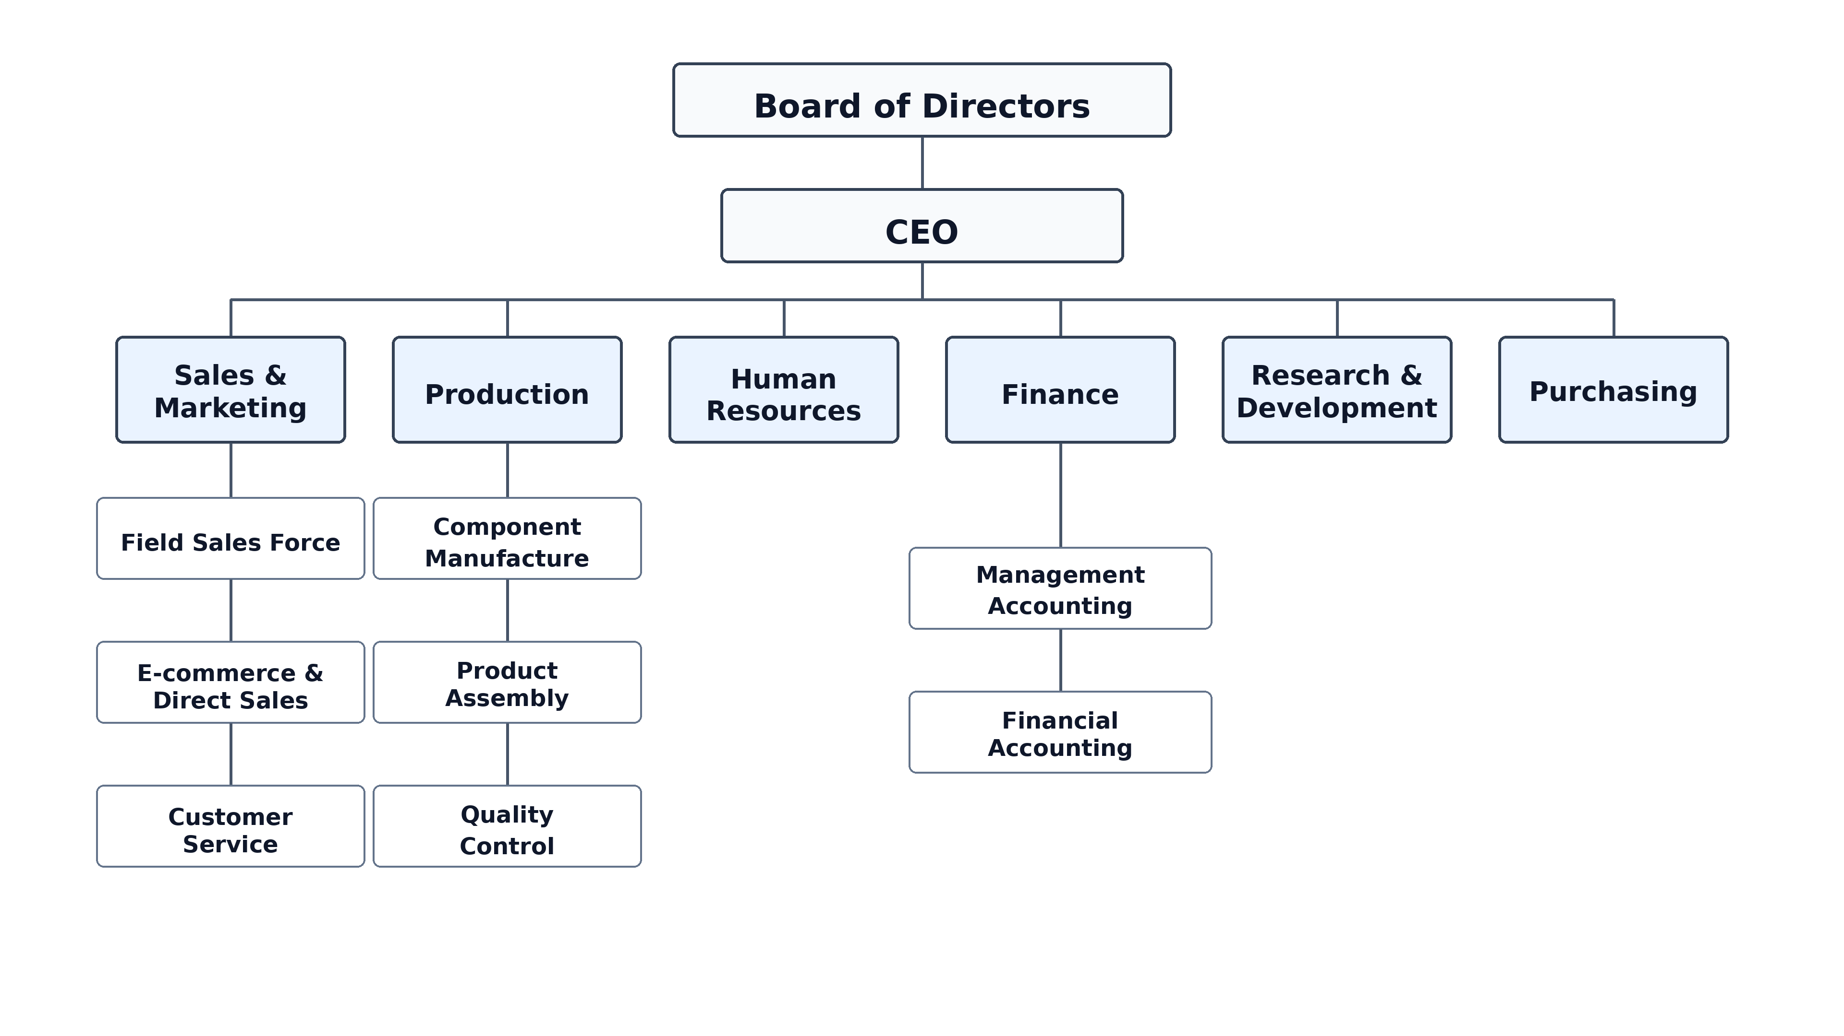
Characteristics of a System
Organization
Implies structure and order.
The arrangement of components that helps to achieve objectives.

Slide 7
Characteristics of a System
Interaction
How each component functions with other components.
Communication and exchange of information, energy, or resources between the components of a system.
Essential for coordination and functionality.
Interdependence
Dependence of each subsystem or component on others.
Certain subsystem may need the outputs of other subsystem as input.
Ensures the contribution of each subsystem to achieve the system objectives.

Slide 8
Characteristics of a System
Integration
Concerned with how a system is tied together.
The harmonious functioning of all components as a unified whole.
All the parts of the system need to work in sync even if their jobs are unique.
Proper integration maximizes the system's output and effectiveness.
Central Objective
Guides the functioning and alignment of all components.
It can be real or stated.
A company might state that its primary objective is to "serve customers," but in reality, its operations might prioritize maximizing profit.

Slide 9
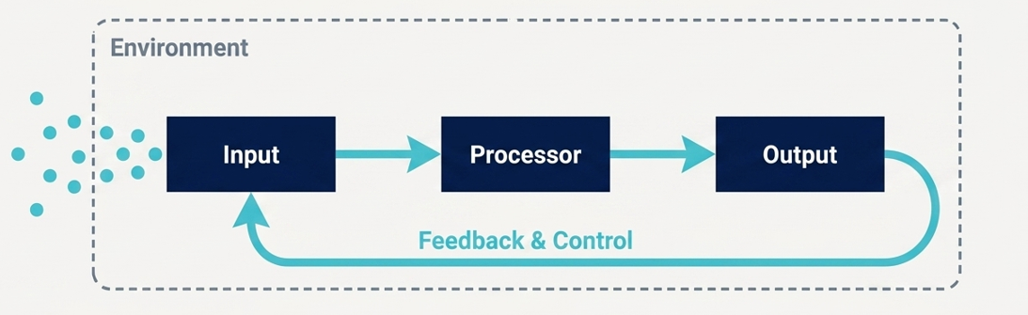
Elements of a System
Inputs and outputs
Processors
Control
Feedback
Environment
Boundaries and interface

Slide 10
Elements of a System
Inputs and outputs
A system’s main objective is to produce an output that meets the expectations of its intended users.
Inputs are processed by the system to generate the desired output.
Determining the output is the first step in defining the required input and processing design, as seen in systems analysis.
Processors
Involves the actual transformation of input into output.
It is the operational component of a system.
Notes:
InputStudent admission data, course registration, attendance data from biometric/RFID, marks from teachers, tuition fee payment data, library book issue data.
Process / ProcessorThe system processes student registration, calculates attendance percentage, generates exam results, checks fee status, sends notices, updates library records.

Slide 11
Elements of a System
Control
A decision-making subsystem.
Governs the input, processing, and output of a system to ensure its balance.
Feedback
Control in a dynamic system is achieved through feedback.
Measures output against standards and may lead to changes in input, processing, or output.
Can be positive or negative.
Vital to identify issues, justify changes, and improve performance.
Notes:
ControlUniversity rules and policies control the system. Example: a student cannot sit for exam if attendance is below 70% or tuition fee is unpaid
FeedbackStudents give feedback about teachers, courses, system errors, result problems, or service quality through online forms

Slide 12
Elements of a System
Environment
The external elements that impacts the system.
Often determines how a system must function.
Boundaries and Interface
A system’s boundaries determines its scope and interface with other systems.
Boundaries help identify what a system includes and excludes.
Notes:
EnvironmentUGC rules, education ministry policy, job market demand, technology changes, internet availability, social and economic conditions
BoundaryThe system boundary includes university students, teachers, departments, admin office, accounts, exam office, library, and official university portal
Boundary
The limit that separates the system from outside environment
University campus, company rules, software access limit

Slide 13
Types of Systems
Physical systems
Static or dynamic
Abstract systems
Conceptual models to point out the significant components and relationships.
Open and closed systems
Based on the system’s degree of independence.
Information systems
Notes:
Physical System: A real system that we can see and touch. Computer lab, university campus, library, bus transport system
Abstract System: A conceptual or theoretical system that we cannot physically touch. University grading policy, mathematical formula, organizational structure diagram
Open System: A system that interacts with the outside environment. University system, bank, hospital, business organization
Closed System: A system that has little or no interaction with the outside environment. A sealed chemical experiment, closed watch mechanism, offline calculator system
Static System: A system that does not change quickly with time. University building structure, printed class routine, organization chart
Dynamic System: A system that changes continuously with time. Online student portal, traffic control system, stock market system
Information System: A system that collects, processes, stores, and distributes information. Student management system, library management system, hospital management syste

Slide 14
Open Systems
Has many interfaces with its environment.
Permits interaction across its boundary to exchange inputs and outputs.
Five important characteristics –
Input from outside
Self-adjusting and self-regulating to achieve steady state i.e. equilibrium.
Entropy
To get to steady state and not to run down over time.
Process, output, and cycles
Follows a continuous flow path.
Differentiation
Greater specialization and interaction to increase value.
Equifinality
Goals are achieved through a variety of paths.
Notes:
1. Input from outside
Open system takes resources/data from outside environment.
New students apply for admission, UGC gives academic rules, parents pay fees, companies give job market requirements.
2. Self-adjusting / Self-regulating
The system adjusts itself to remain stable.
If many students fail in one course, the university may arrange extra classes, update teaching methods, or review question difficulty.
3. Entropy
Without proper management, system becomes weak/disorganized over time.
If the university does not update software, train teachers, maintain labs, or revise syllabus, the smart system will slowly become ineffective.
4. Process, output, and cycles
Input is processed, output is produced, then the cycle continues again.
Student admission → class attendance → exams → result → feedback → next semester improvement. This cycle repeats every semester.
5. Differentiation
Different parts become specialized to do different jobs.
Admission office handles admission, accounts handles fees, exam office handles results, library manages books, IT office manages portal, departments handle teaching.
6. Equifinality
Same goal can be achieved in different ways.
University goal is student learning. This can happen through classroom lectures, online LMS, recorded videos, lab classes, group projects, and internships.

Slide 15
Information Systems
Information system –
a set of interrelated components
that collect (or retrieve), process, store, and distribute information
to support decision making and control in an organization
Data are streams of raw facts representing events in the organizations and the environment.
Information means data that have been shaped into a form that is meaningful and useful to human beings.

Slide 16
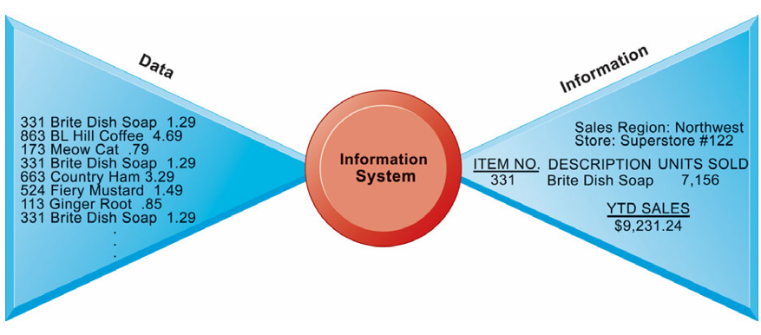
Information Systems
Raw data of a supermarket are being processed to extract useful information

Slide 17
Information Systems
The activities/functions/elements of information systems –
Environment
The external factors that impact and shape the system
Inputs
Captures or collects raw data from within the organization or from its external environment
Processing
Converts this raw input into a meaningful form
Outputs
Transfers the processed information to wherever it will be used
Feedback
Output that is returned to appropriate members of the organization to help them evaluate or correct the input stage
Notes:
An information system works like a cycle — it takes in data, processes it, produces results, and then uses feedback to improve. It has five main parts:
Environment – Things outside the system that affect it.
Inputs – Raw data collected from inside or outside the organization.
Processing – The system changes that raw data into something meaningful.
Outputs – The useful information that comes out and gets shared or used.
Feedback – Information sent back to improve or correct future actions.

Slide 18
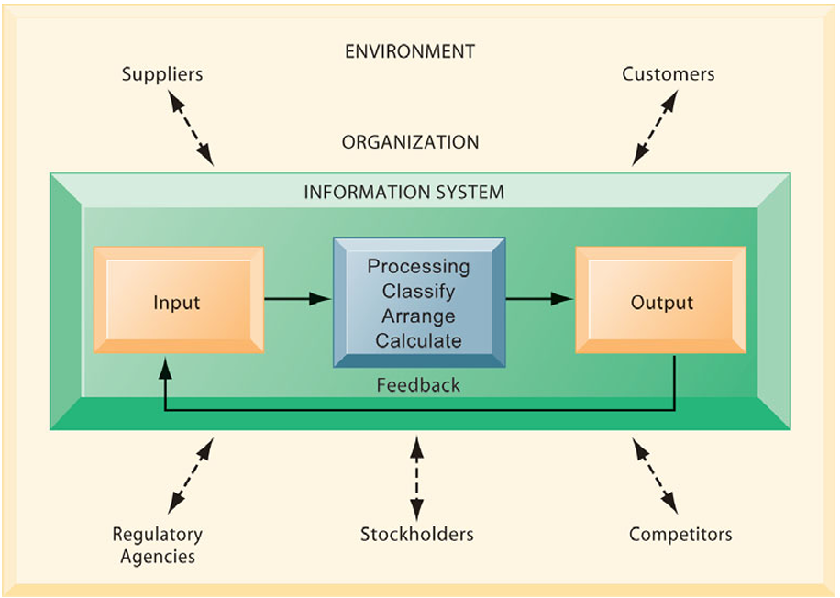
Information Systems

Slide 19
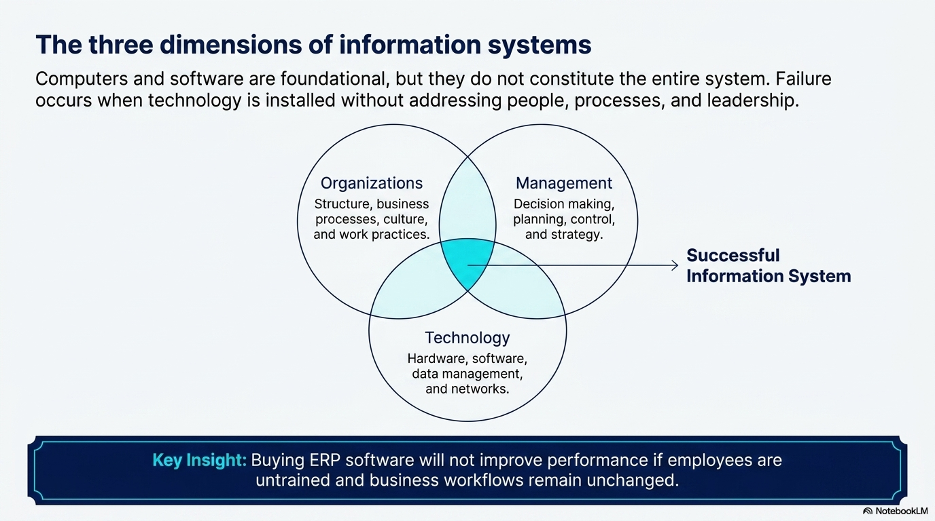

Slide 20
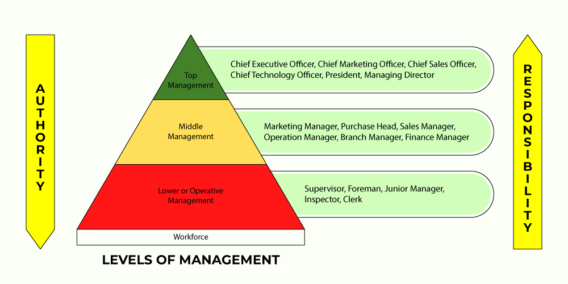
Organizations

Slide 21
Organizations
Top level management
Formulates objectives, plans, and policies.
Makes long-range strategic decisions.
Coordinates and control of the performance.
Analyses of the business environment.
Sets up an organizational framework.
Assembles of the resources.
Ensures financial performance of the firm.
Requires summarized information from a variety of sources to attain goals.
Relatively open, dynamic, and adaptive.
Decisions are mostly judgmental.

Slide 22
Organizations
Middle management
Carries out the programs and plans of senior management.
Interprets of the policies framed by the Top Level Management.
Selects of suitable operative and supervisory personnel.
Assigns of duties and responsibilities to the Lower Level Management.
Motivates employees to get desired objectives.
Cooperates with the entire organization.

Slide 23
Organizations
Lower management
Also known as Supervisory or Operational Level Management.
Issues of orders and instructions.
Makes day-to-day, relatively structured control decisions.
Monitors the daily activities of the business.
Assigns and assists the workers
Represents workers’ grievances.
Ensures a safe and proper work environment.
Helps the middle level management.
Encourages initiative of employees.
Needs detailed internal information.

Slide 24
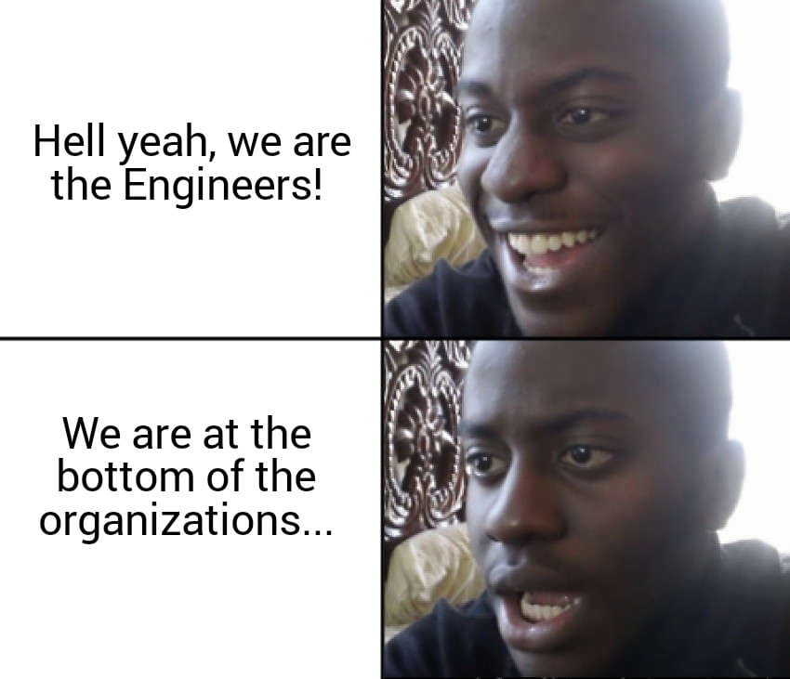
Organizations
Workforces include –
Data workers
Clerks, secretariats, etc.
Knowledge workers
Engineers (😔), scientists, architects, etc.
Production workers
Service workers
And, many others

Slide 25
Organizations
Business functions
Sales, marketing, manufacturing, production, finance, accounting, HR, etc.
Formal rules
Informal work practices
Automation
Differing perspectives, conflicts, compromises, and agreements.
Unique culture
Fundamental set of assumptions, values, and ways of doing things.
Accepted by most of its members.
Notes:
1. Business Functions
Every organization has different departments or functions.
Examples:
Sales and Marketing: promote products or services.
Production: creates the main product or service.
Finance and Accounting: manages money, salary, budget, and expenses.
HR: hires employees and manages staff.
Example: In a university, admission office, accounts office, exam office, departments, and library all work together.
2. Formal Rules
Formal rules are official rules of the organization.
Examples:
Office time is 9 AM to 5 PM.
Students must attend 70% classes.
Employees must follow leave policy.
Teachers must submit marks before the deadline.
These rules help the organization run properly.
3. Informal Work Practices
Informal work practices are unofficial ways people do their work.
Examples:
Teachers share notes with students through WhatsApp.
4. Automation
Automation means using technology to do work faster and with less manual effort.
Examples:
Online admission system
Biometric attendance system
Online result system
Automatic fee payment system
Library book management software
5. Different Opinions and Conflicts
People in an organization may have different ideas, needs, and goals.
Examples:
Teachers may want more time to finish syllabus.
Administration may want exams on fixed dates.
6. Unique Culture
Every organization has its own culture.
Culture means the common values, habits, and ways of working accepted by most members.

Slide 26
Dimensions of Information Systems
Management
Manage what already exists.
Create new products and services.
If needed, re-create the organization.
Information Technology Infrastructures
Provides the foundation, or platform, on which the firm can build its IS.
Hardware and software.
Data management technology.
Networking and telecommunications technology.

Slide 27
Information Systems
Information system enables the firm to –
increase its revenue or decrease its costs by providing information
that helps managers make better decisions
that improves the execution of business processes
The decision to invest in any new information system is determined by the extent to which the system will lead to –
better management decisions
more efficient business processes
higher firm profitability

Slide 28
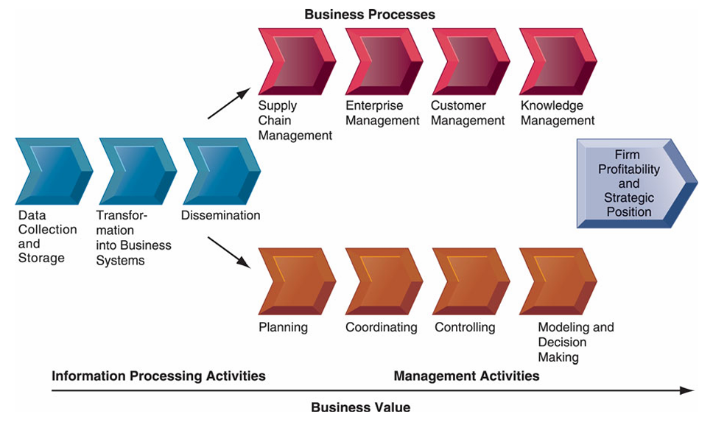
Information Value Chain
Technology creates value only when information leads to better human action.
Notes:
Information Value Chain means the process of converting raw data into useful information, and then using that information to make better decisions and create business value.
1. Data Collection and Storage
Collect raw data and store it
Customer orders, payment data, product views, delivery status, customer reviews
2. Transformation into Business Systems
Convert raw data into useful business information
Sales reports, stock reports, customer behavior analysis
3. Dissemination
Share information with the right people/departments
Inventory team gets stock alerts, marketing team gets customer interest reports
4. Business Processes
Use information to improve daily operations
Supply chain manages stock, customer management handles complaints, knowledge management improves service
5. Management Activities
Managers use information for decisions
Plan discounts, control delivery delays, decide which products to promote
6. Business Value
Final benefit for the organization
Higher profit, faster delivery, better customer satisfaction, stronger market position

Slide 29
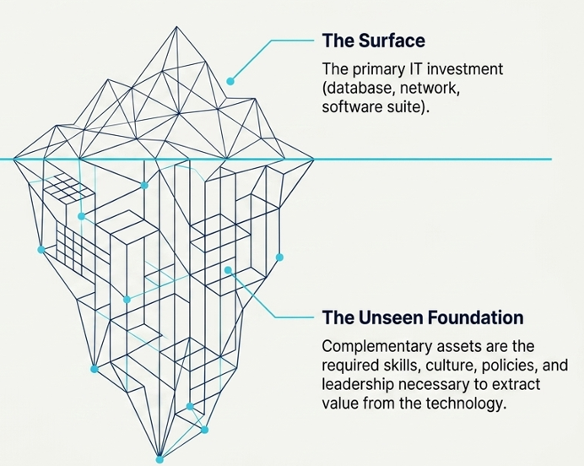
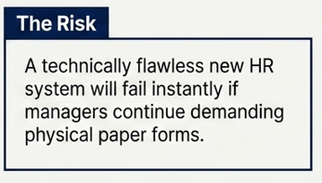
Complementary Assets
Information technology alone does not guarantee good returns. Value is only generated when paired with supporting non-technical assets.
Notes:
Complementary assets are the supporting factors that help an organization get the full benefit from its investment in information technology.

Slide 30
Complementary Assets
Strong management support – leadership that knows how to use IT strategically.
Skilled employees – who can operate new systems and adapt to technological changes.
Efficient business processes – workflows that fit with the new system.
Organizational culture – encourages innovation, sharing, and continuous improvement.
Proper legal and social environment – laws, policies, and market conditions that favor IT adoption.

Slide 31
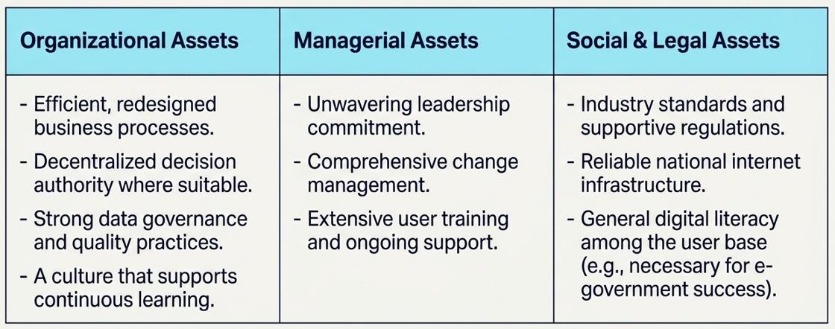
Complementary Assets
Organizations must intentionally develop three groups of complementary assets:
Notes:
1. Organizational Assets
Internal structure and work processes that support the system
The university must redesign admission, course registration, attendance, exam, result, and payment processes so they work smoothly online.
2. Managerial Assets
Support and guidance from management
Top management must strongly support the smart university project, manage change, and ensure teachers, students, and staff use the system properly.
3. Social & Legal Assets
External rules, infrastructure, and social readiness
The system needs education board/UGC rules, data privacy policy, reliable internet, and students/teachers who can use digital tools.

Slide 32
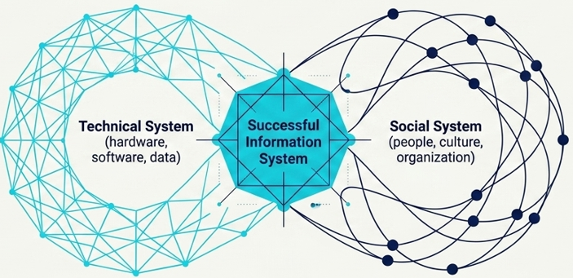
Study on Information Systems
The study of information systems and their development is a multi disciplinary subject.
It addresses the range of strategic, managerial and operational activities involved in the gathering, processing, storing, distributing and use of information, and its associated technologies, in society and organizations.
It examines more than just the technological system, or just the social system. It investigates the phenomena that emerge when the two interact.
Notes:
1. What it studies: The study of Information Systems (IS) looks at how information is collected, stored, processed, shared, and used in organizations and society.
2. Multi-disciplinary: It combines ideas from technology (like computers and software) and social sciences (like management, behavior, and communication).
3. Focus:
Not just about computers or technology.
Not just about people or social systems.
Focuses on what happens when technology and people work together.

Slide 33
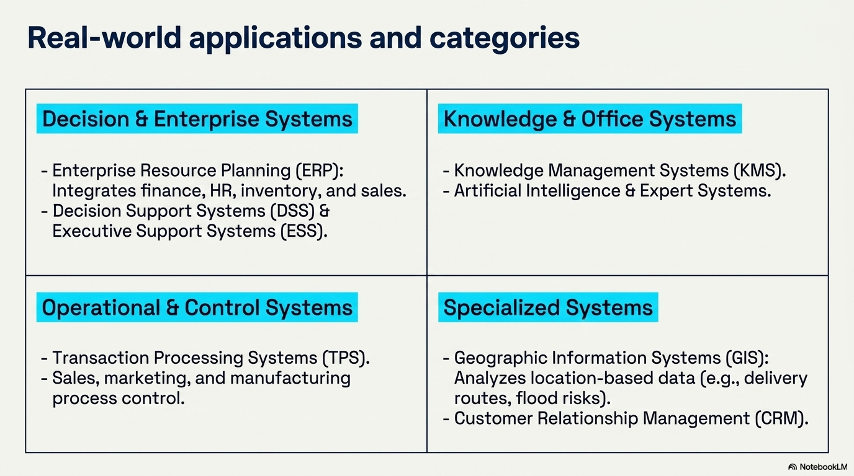

Slide 34
The END

